Slide 2
Aim
I can explain what mindfulness is and understand how it can help me.
Success Criteria
I can recognise when my mind wanders.
I can identify how mindfulness helps to settle my mind.
I can use the breath to help me feel calm.

Slide 3
The Big Questions

Slide 4
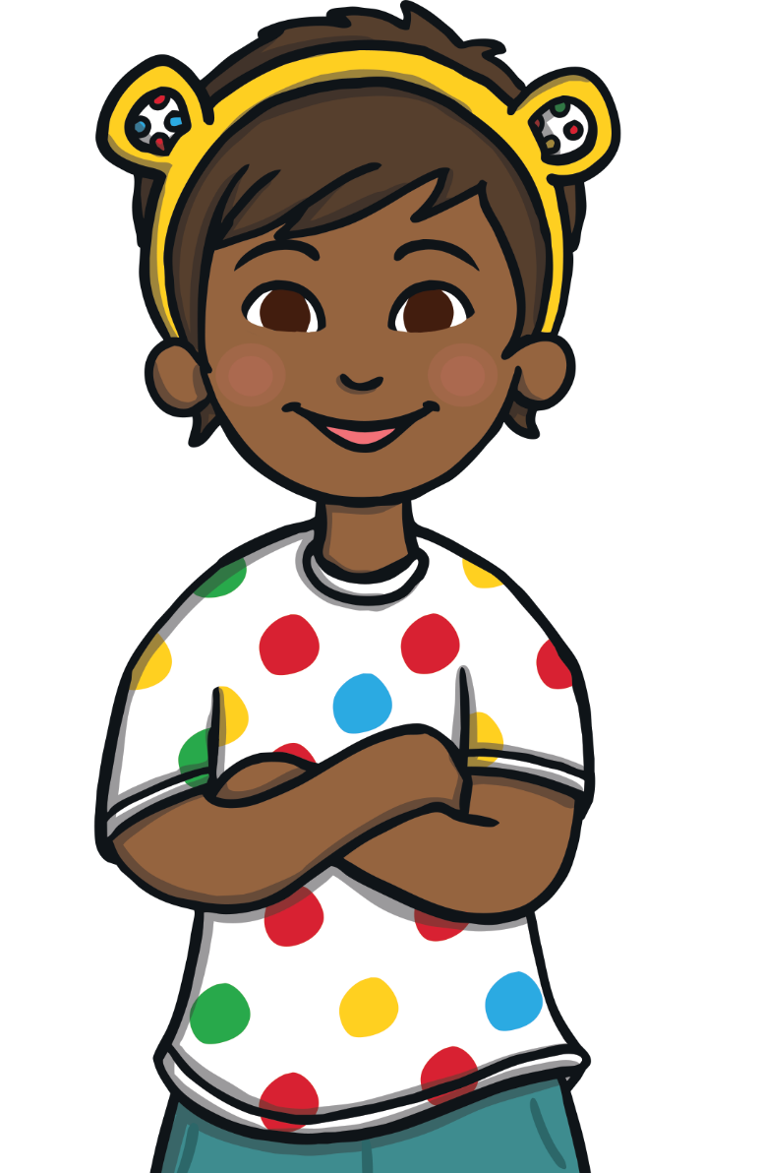
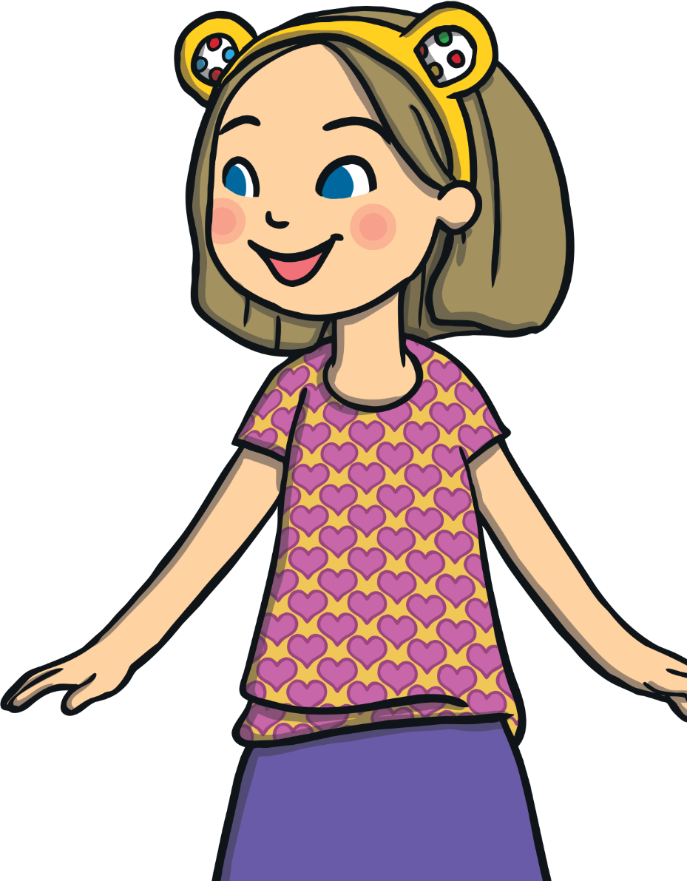
The Big Questions
What is mindfulness?
How can mindfulness help me?

Slide 5
Reconnecting

Slide 6
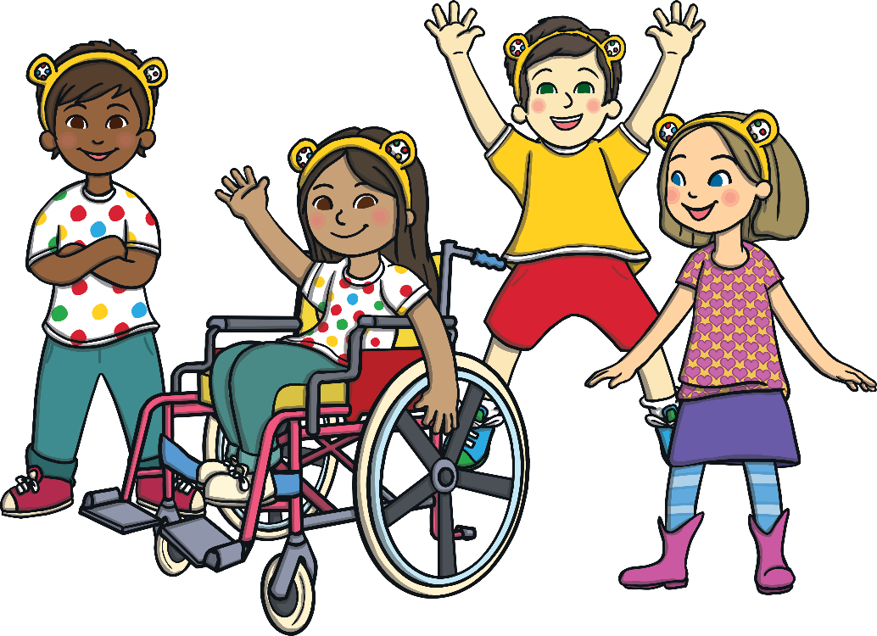
Feeling Happy and Calm
BBC Children in Need is a charity which helps young people and disadvantaged children throughout the United Kingdom.
BBC Children in Need’s vision is that every child in the United Kingdom has a childhood which is safe, happy and secure and which allows them the chance to reach their potential.

Slide 7
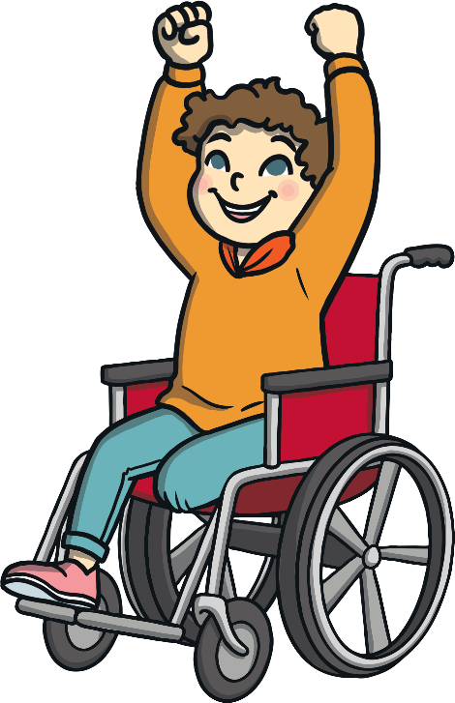
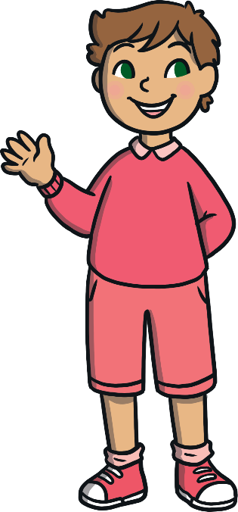
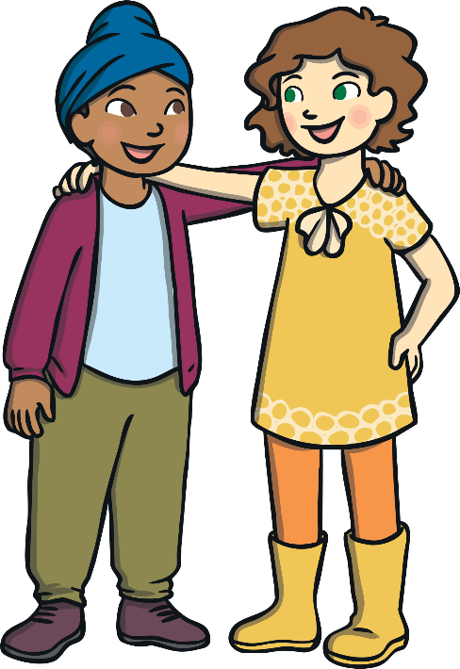
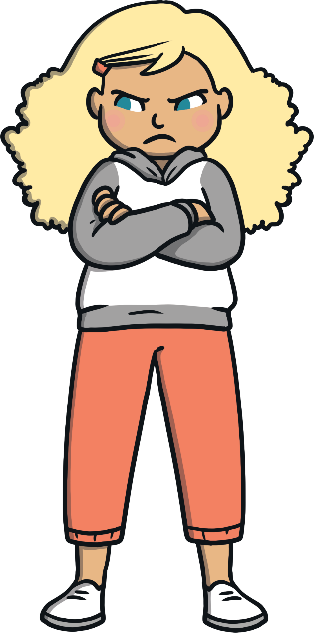
Feeling Happy and Calm
One way in which we can help ourselves and others to feel happy is to look after our own mental health and that of others.
Taking time to look after our minds and help others feel good on the inside can help us all to feel happy and calm.
Mental health is all about the thoughts and feelings we have. It can affect how we behave and the choices we make.
We can help look after our mental health by being kind to ourselves and to others.
What other ways can we help ourselves and others to feel happy and calm?

Slide 8
Exploring

Slide 9
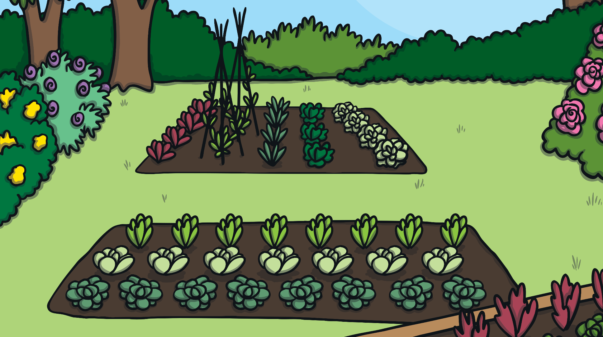
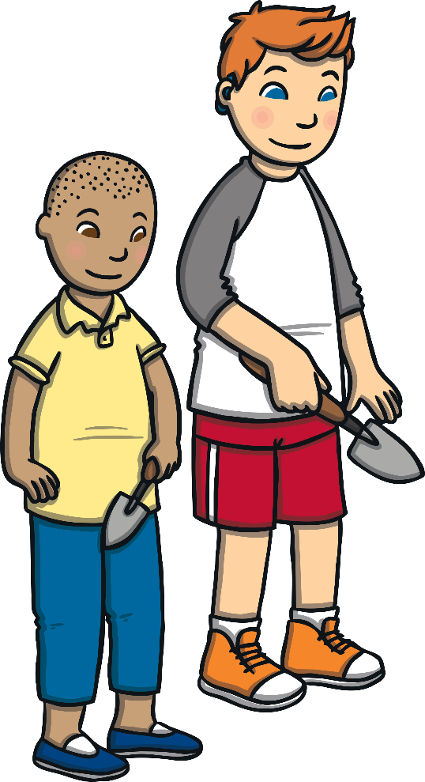
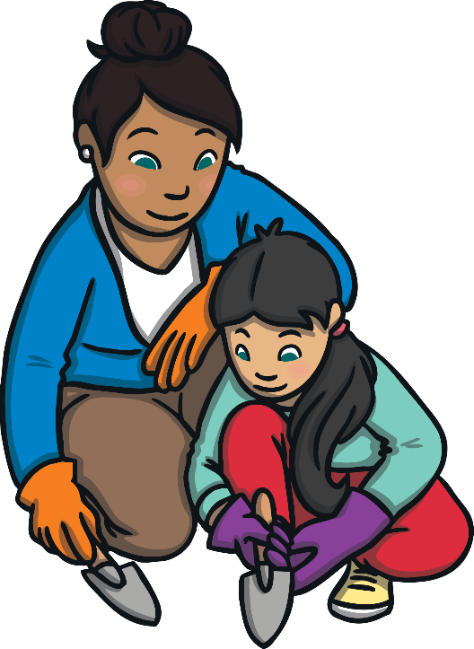
Being Mindful
Learning to be mindful is one way we can look after our mental health.
Being mindful means we are aware of ourselves and the world around us.
It helps us to be present in the moment.

Slide 10
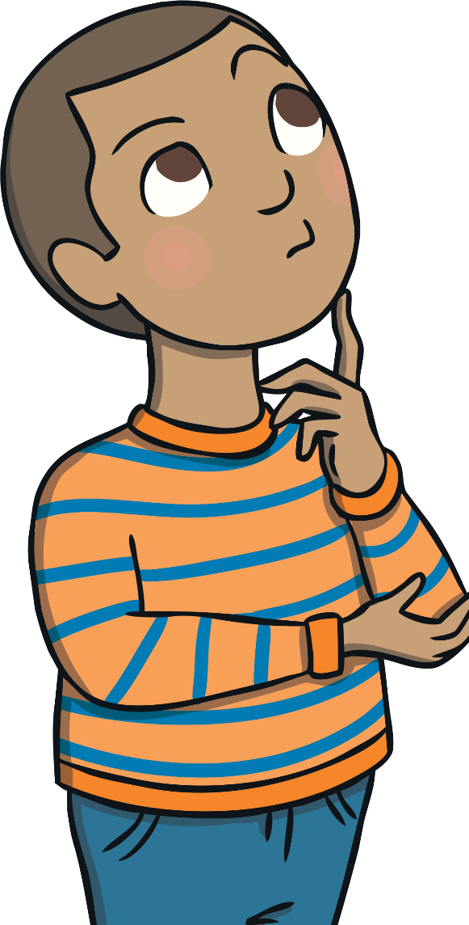
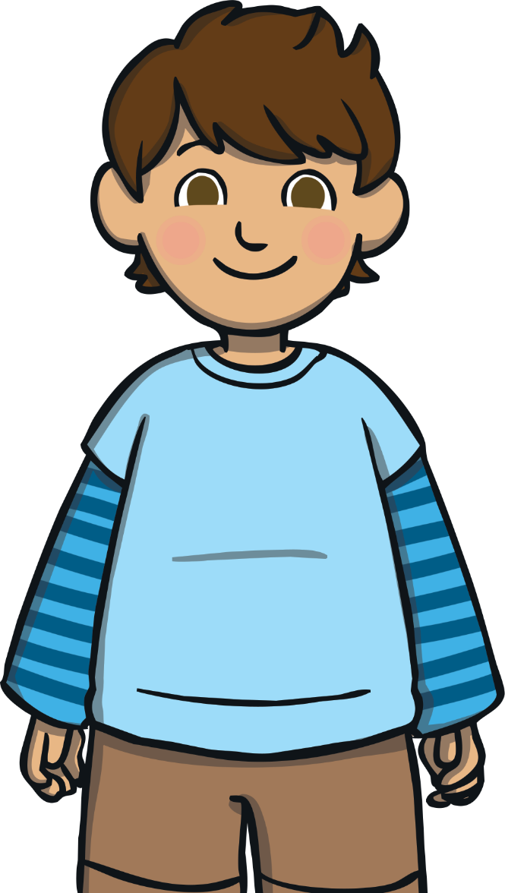
Being Mindful
Mindfulness helps us to understand ourselves, our behaviour and our habits.
Through mindfulness, we learn to pay attention to our thoughts, our emotions and physical sensations.
We can then see how these affect our mood and behaviour.
Practising mindfulness trains us to be more focused, settled and calm.

Slide 11
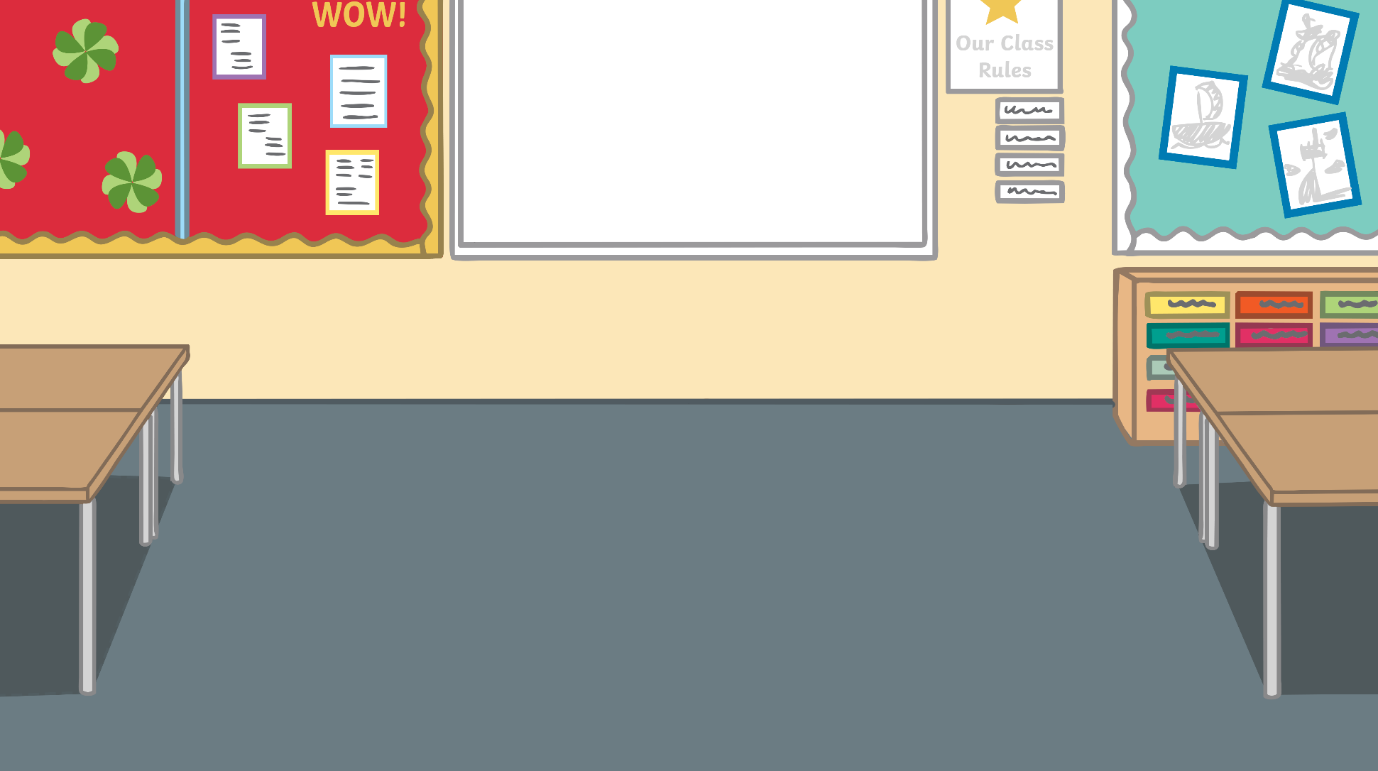
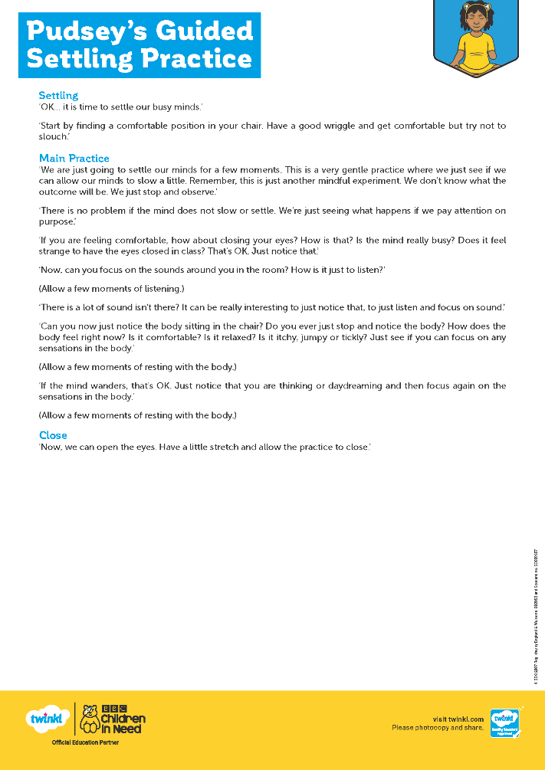
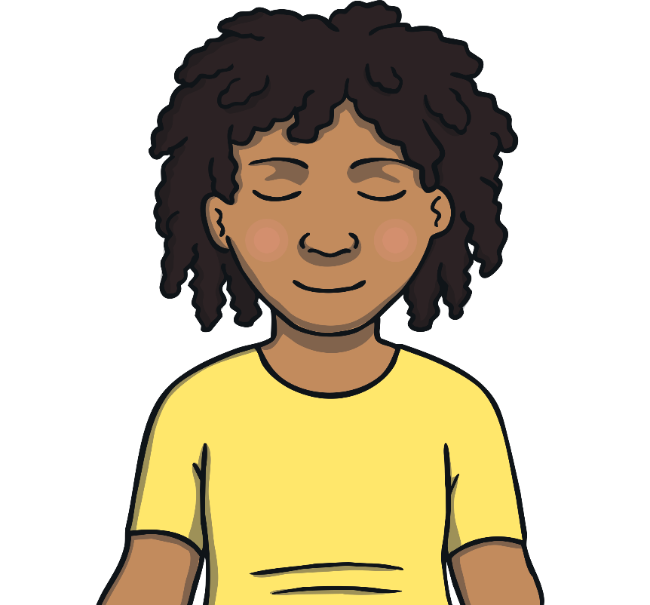
Being Mindful
Let’s have a go at being mindful!
If you feel happy to, share your thoughts with the class.
How did being mindful make you feel?

Slide 12
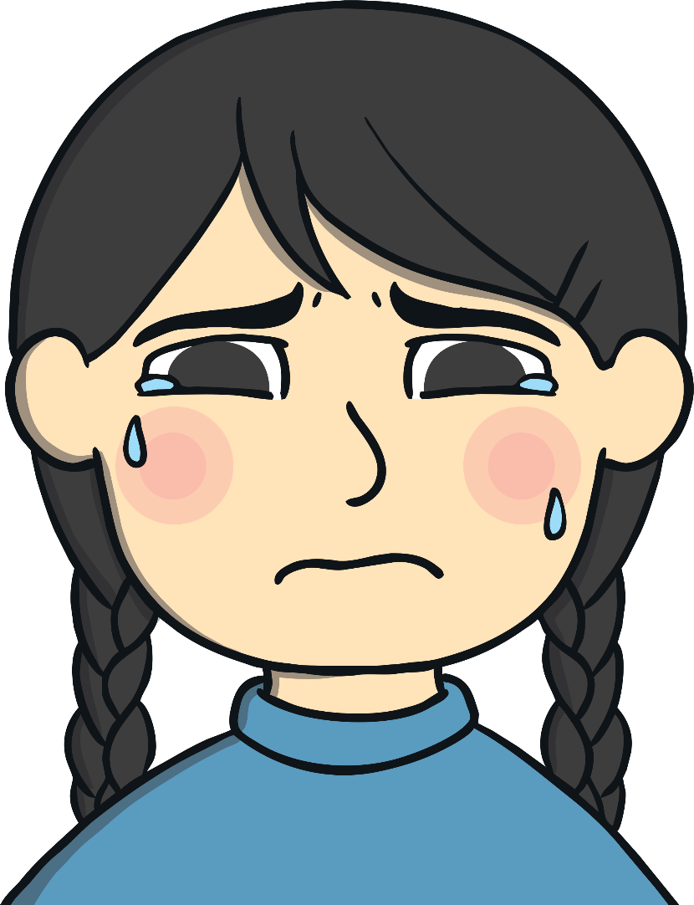
The Scattered Mind
Do you ever feel that your mind is unsettled and full of thoughts?
This is the mind being ‘scattered’.
When our mind is busy with racing thoughts and feelings, we can feel worried and unsettled.
Your brother, sister or friend is doing something that annoys you.
You have homework to do.
You need to tidy your bedroom.
It is quite normal to have a scattered mind but it can make it very difficult to concentrate.
Learning to pay attention helps us notice when our mind has become ‘scattered’. Mindfulness helps settle our busy minds, helping us to feel calmer and happier.

Slide 13
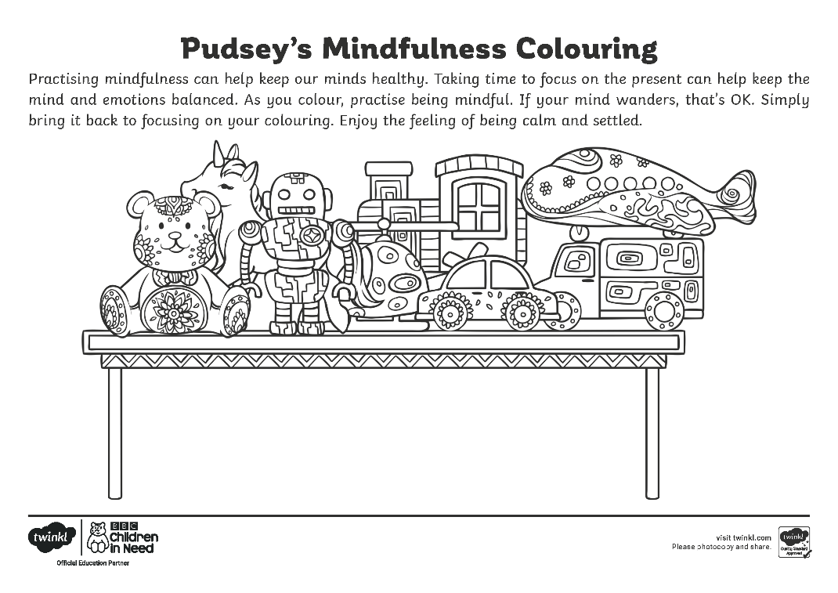
The Scattered Mind
Activities, such as colouring, are calming and settling mindfulness exercises.
Colour the picture on your Pudsey’s Mindfulness Colouring Sheet.
Be mindful of what you are doing; the feel of the pen or pencil in your hand and on the paper and how the colours look.
If your mind starts to wander, this is OK. Recognise it has drifted and then bring your attention back to the picture and the colours you are using.
How did being mindful when you were colouring make you feel?
Did it help your scattered mind feel settled?

Slide 14
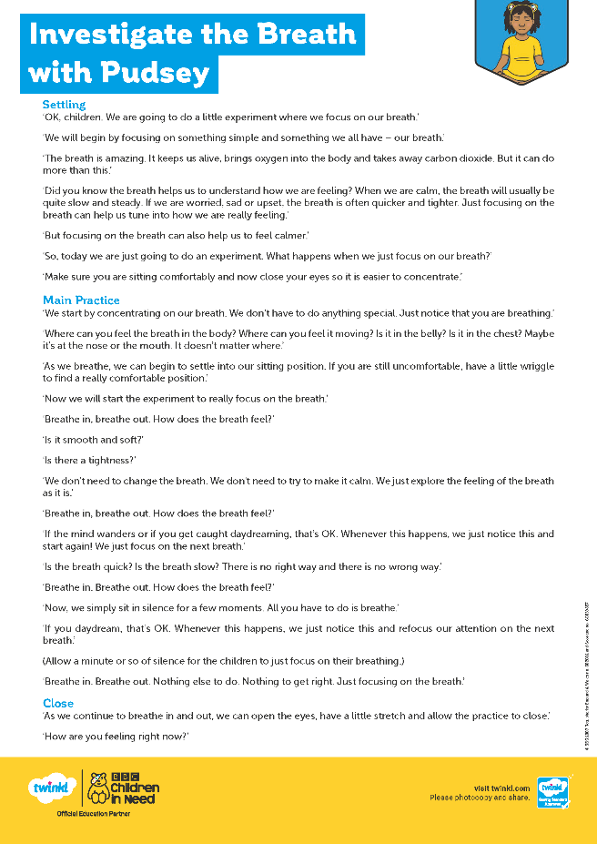
The Breath
We have a mindfulness tool that we can take with us wherever we go! Does anyone know what it is?
The breath is always with us. It is something we can always call on to help us whenever we need it.
Consolidating
Reflecting
Focusing on the breath and being mindful of what it feels like as we breathe in and out can help our minds to settle.
Let’s practise being mindful of the breath!

Slide 15
Consolidating

Slide 16
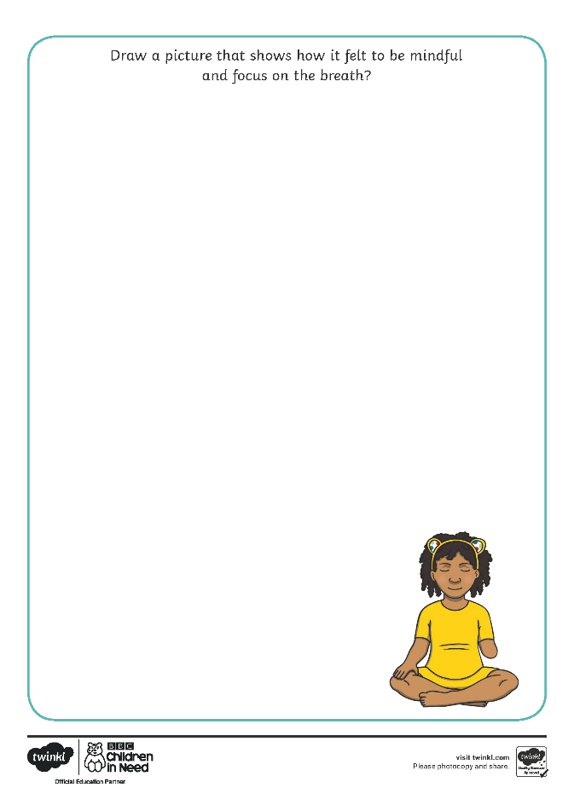
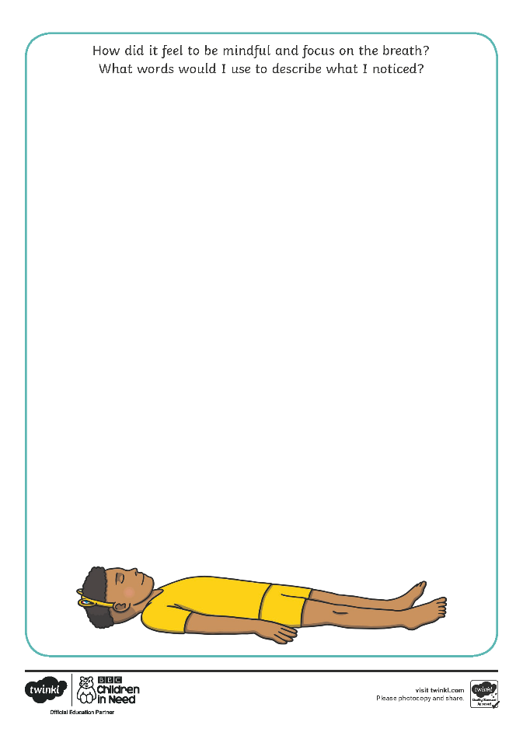
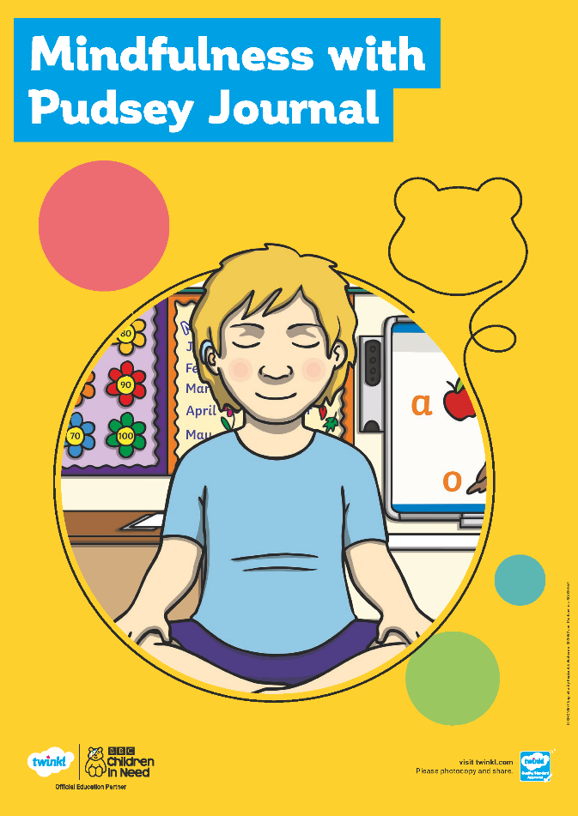
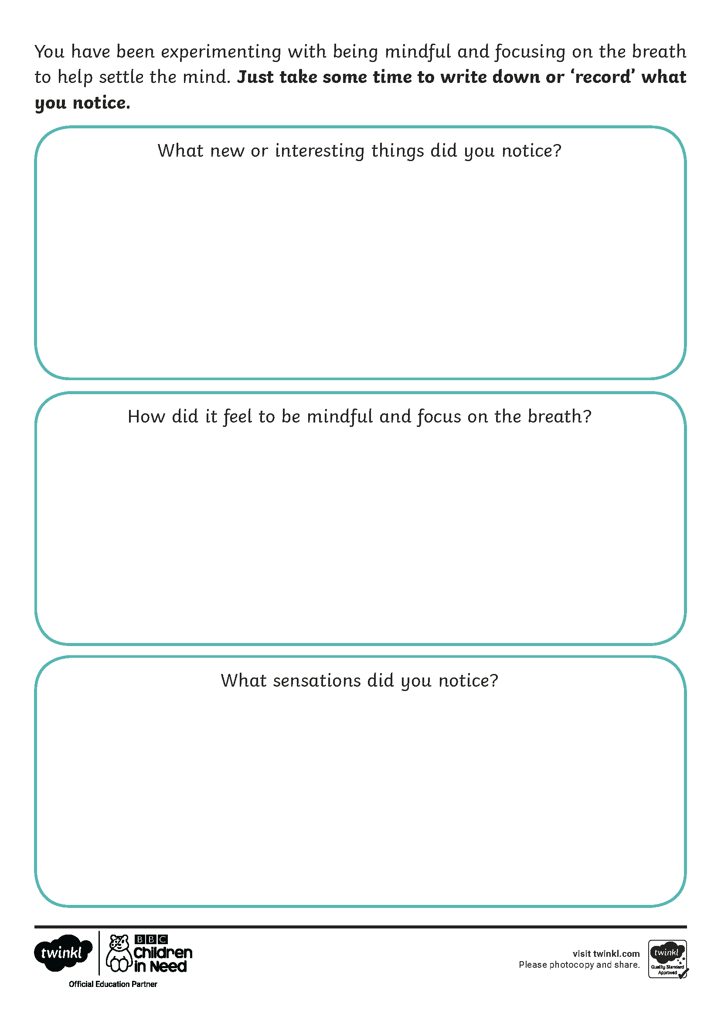
Pudsey’s Journal
Record how you have felt during our mindfulness lesson on your Mindfulness with Pudsey Journal Activity Sheet.

Slide 17
Reflecting

Slide 18
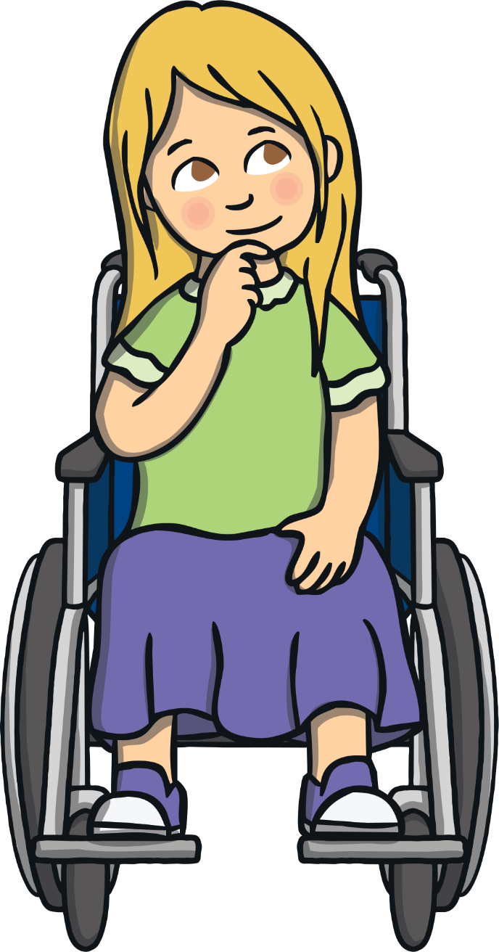
Discussion Time
What is mindfulness?
How can mindfulness help me?
How will you use mindfulness in your daily activities to help you feel settled, calm and happy?
Share your thoughts with a partner and then, if you feel happy to, with the class.

Slide 19
Discussion Time
The mind is naturally scattered.
Mindfulness helps settle the mind.
Learning to focus the mind can help us to feel calm.
This can help us better understand our feelings and emotions.
It can help us to not get so distracted by our thoughts.
Practising mindfulness can have a positive impact on how we feel and on our mental health.

Slide 20
Aim
I can explain what mindfulness is and understand how it can help me.
Success Criteria
I can recognise when my mind wanders.
I can identify how mindfulness helps to settle my mind.
I can use the breath to help me feel calm.

