Slide 1

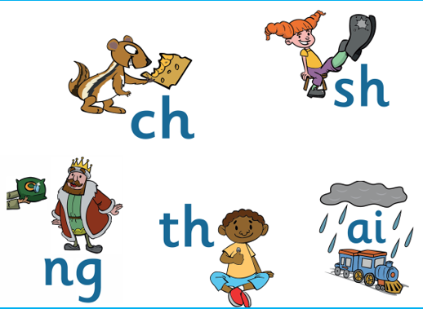


Slide 2
What is phonics?
Schools in the UK, and increasingly around the world, teach children to read using ‘Synthetic Phonics’. This is simply a way in which we break words down into the smallest sounds. So, the sounds in the word ‘cat’ are /c/ /a/ /t/. We are saying words in an unnatural, or synthetic way.
We are at the beginning stages of using FFT Success for All Phonics programme to teach your children phonics, which has been validated by the Department of Education and meets all their requirements for the teaching of phonics in schools. Every day your child will have about a 25-minute phonics lesson where they will be taught all the skills they need to use phonics to decode words for reading, and to break words down for spelling.
Your child will learn to read and write using phonics because it will be taught systematically. They will learn new skills and then learn to apply them by reading texts before moving on to the next skill.
In many ways, you can be guided by your child. They will understand the process well and may be able to help you through it. If you aren’t confident and need more support, ask a teacher, who will happily help.
Notes:
Read out – taken from the programme guide. Explain – your children have already been learning phonics in this way

Slide 3

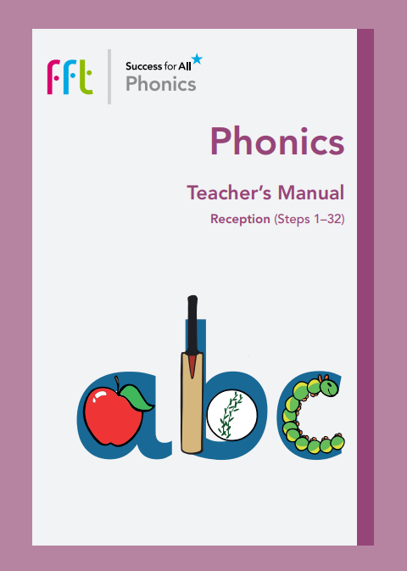
Notes:
Letters and Sounds now outdated. Move to new scheme which is a fully resourced programme which aims to get children reading quicker with more confidence.

Slide 4
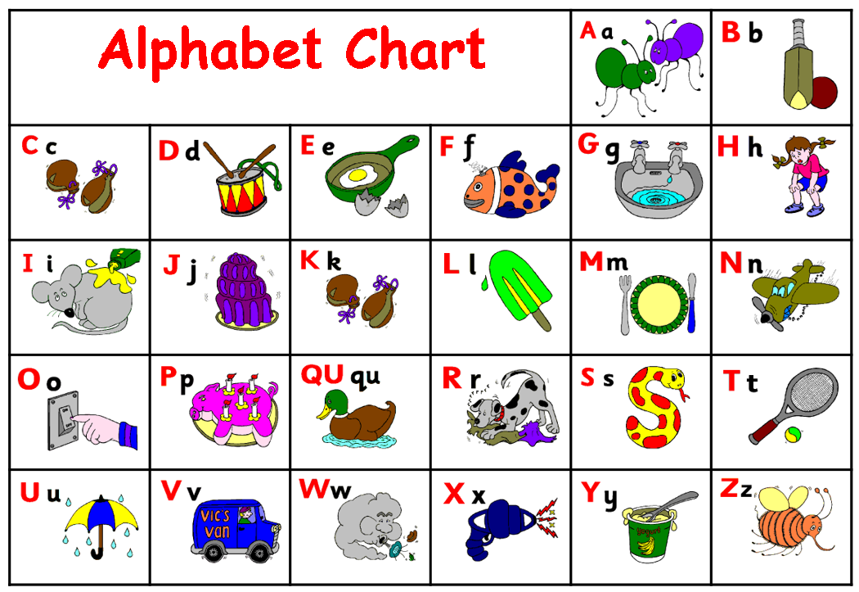
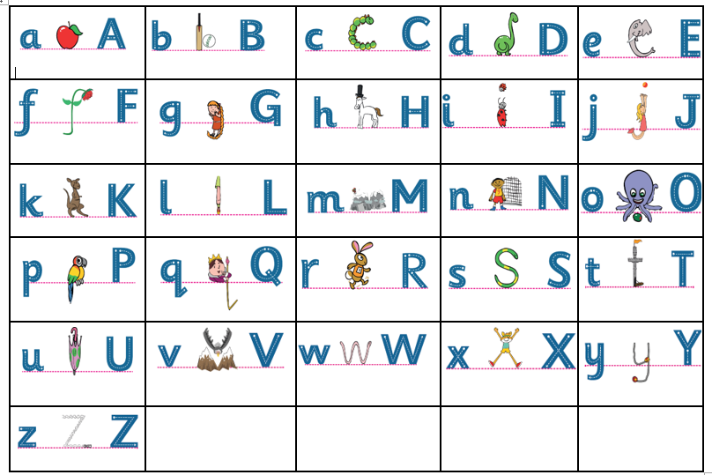
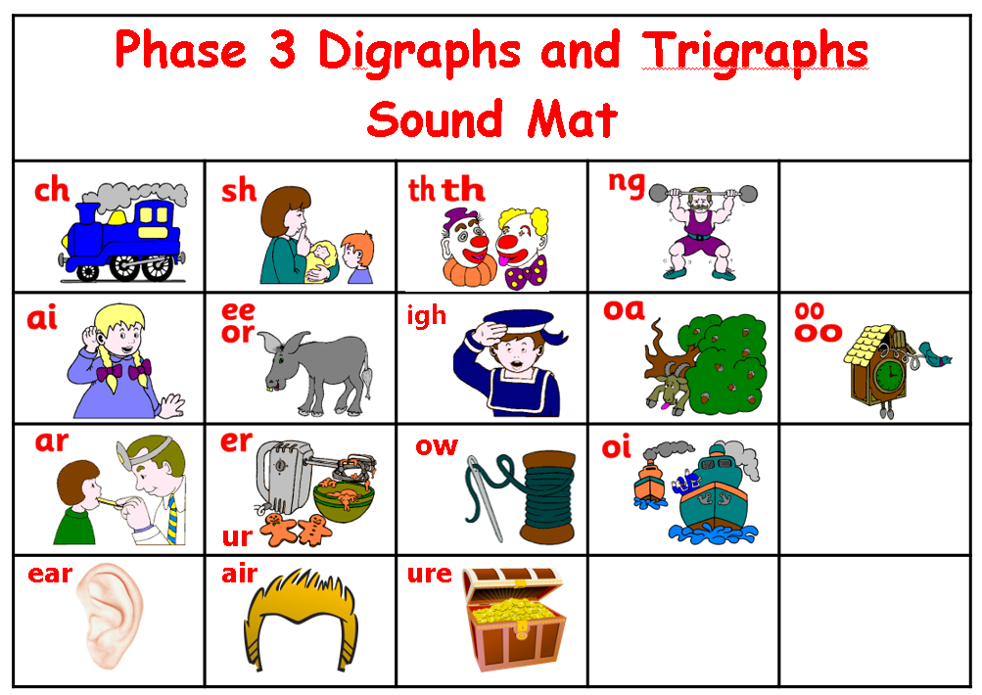
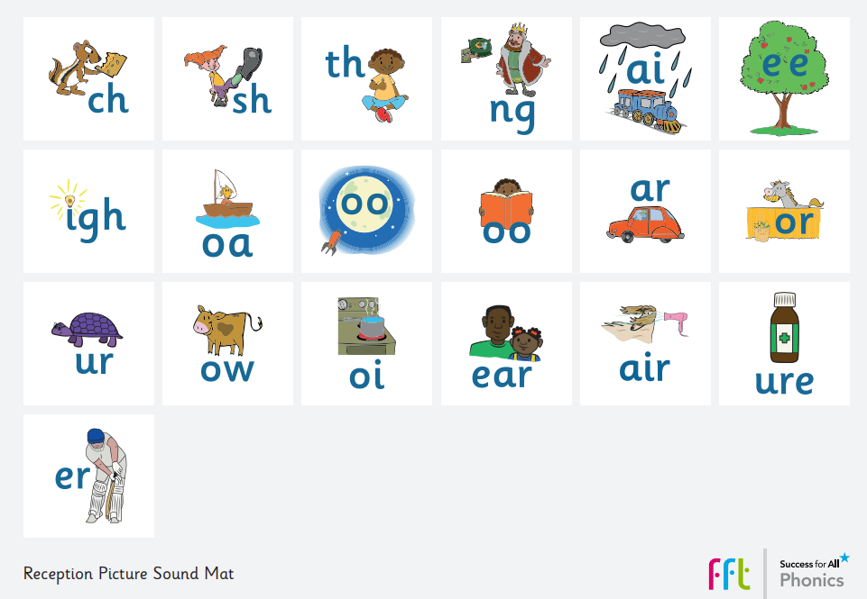
Notes:
Old scheme vs new scheme. Letter formation chart / sound mats. Mention importance of consistency.

Slide 5
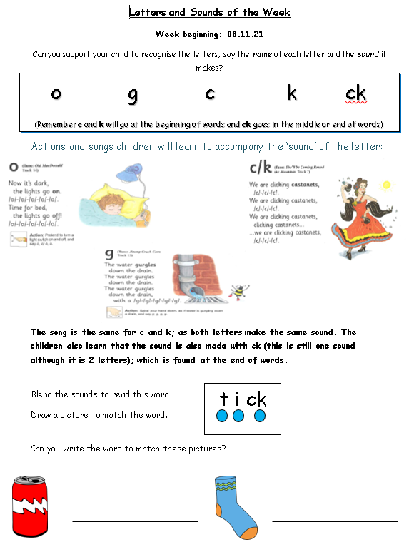
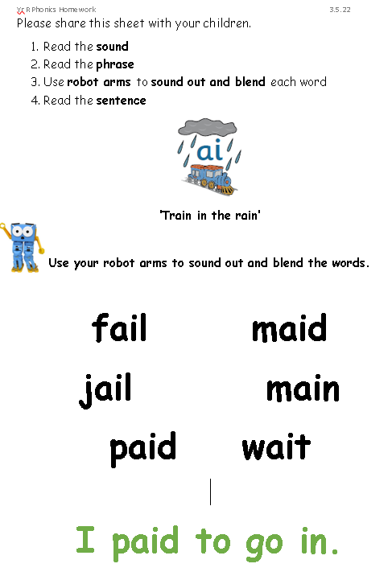
Notes:
Year R homework now simplified

Slide 6
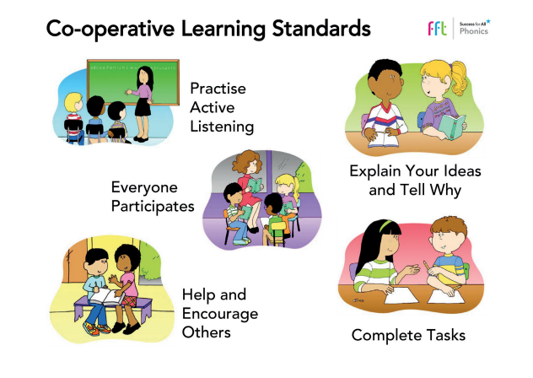
Notes:
The programme promotes co-operative learning between children which enables them to build their social skills whilst learning to read. Learners support each other.

Slide 7
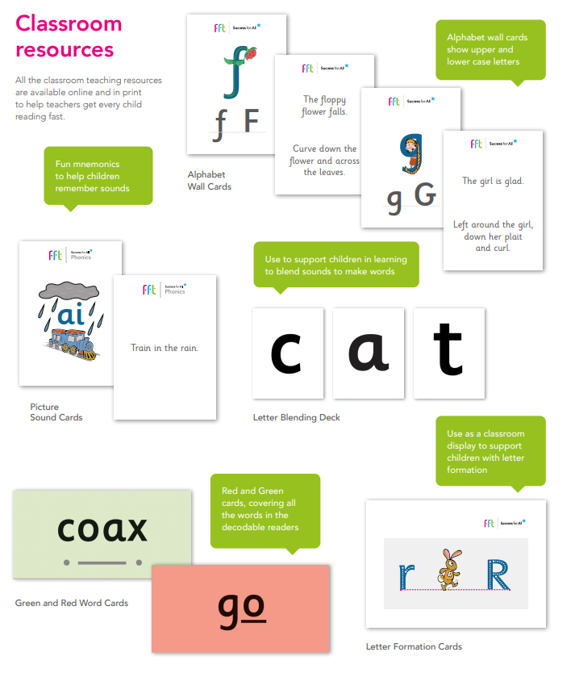
Notes:
Discuss how each new sound is introduced to the children with a phrase containing words with the sound.
Explain – stretch and read (segmenting and blending)

Slide 8
Notes:
Green words – fully decodable. Children only expected to read words that have sounds that have learnt.
Red words – tricky words – we look at the tricky part of the word
Letter formation – lower case and capital together with the corresponding picture from phonics

Slide 9
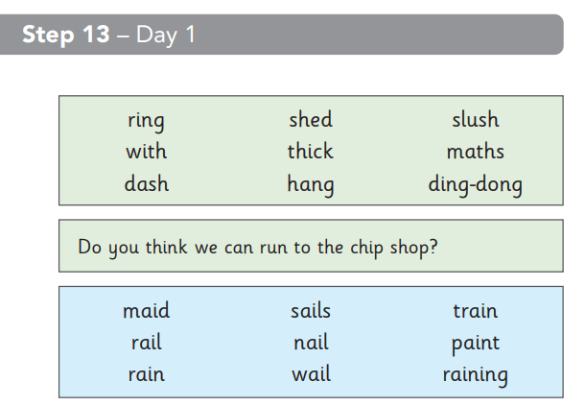
Notes:
Revisit/ review – GPCs and then variety of words/ sentences containing the sounds already taught

Slide 10
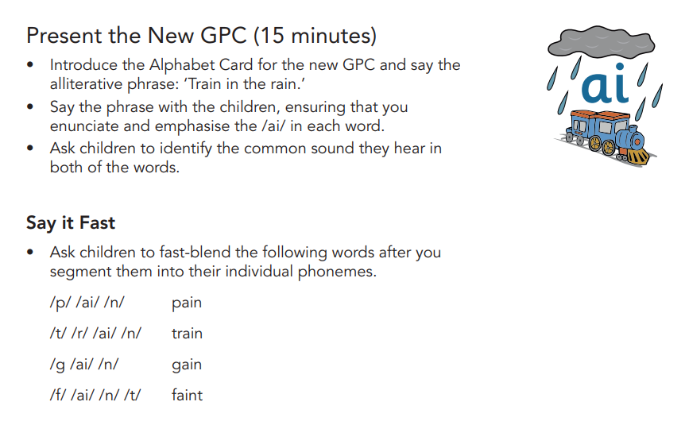
Notes:
Present new GPC
Say it fast - demonstrate

Slide 11
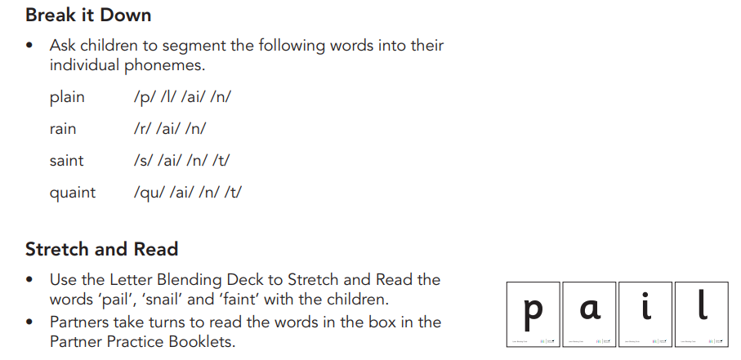
Notes:
Demonstrate

Slide 12
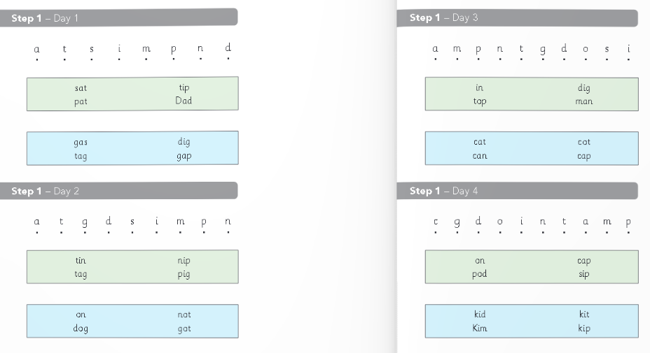
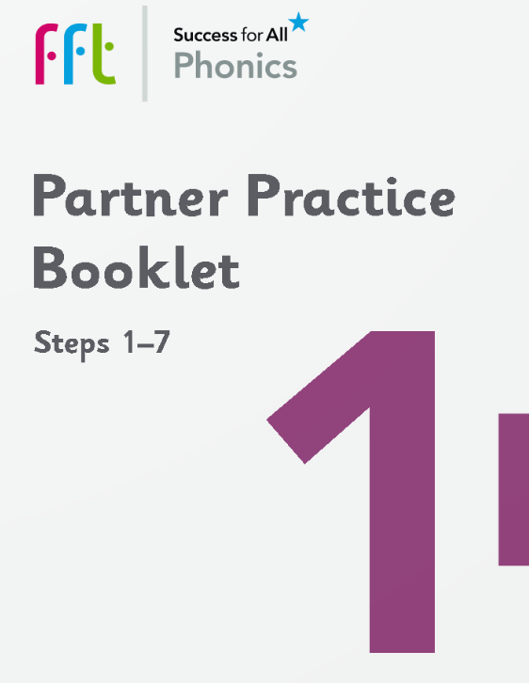
Notes:
Co-operative learning. Taking turns/ checking each other’s reading

Slide 13
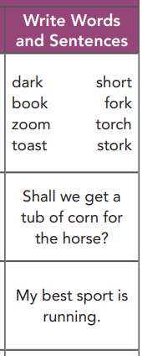
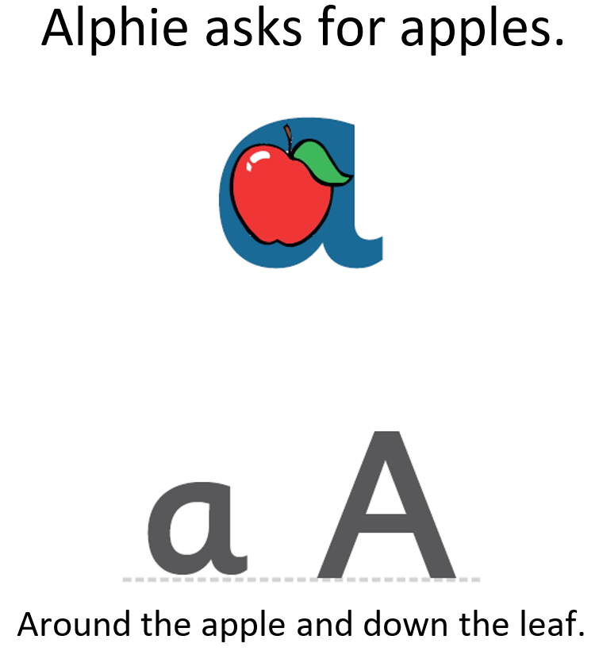
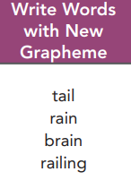
Notes:
Discuss progression from letter formation > writing words > writing sentences
Discuss revisit / revise of sounds for writing each day.

Slide 14
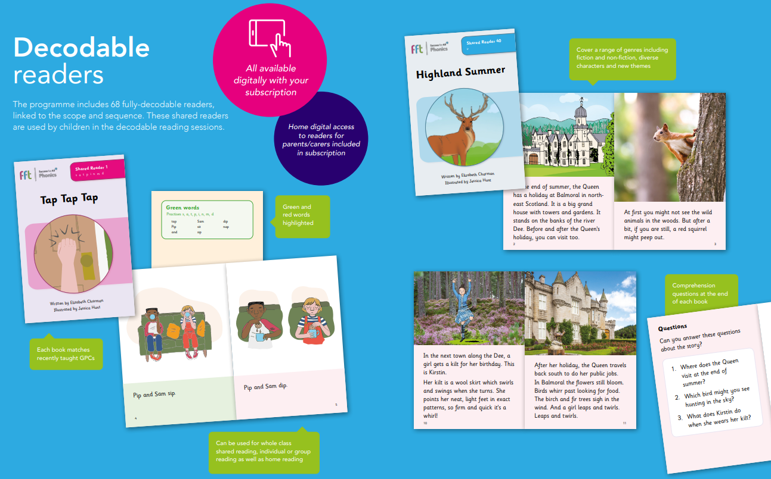
Notes:
Fully-decodable readers – allows children to practice and apply what they have learnt in the phonics lesson. Green and red words.
Co-operative learning.

Slide 15

https://parents.fft.org.uk/
Notes:
How can you help at home?
Weekly homework
Accessing books on Parent Portal to practice at home. Link to portal/ passcode will be sent out via Parent mail. Works on laptops/ desktops/ tablets and smartphones.
Demo portal live. Open a reader and show how we would model reading a sentence/ sounding out/ reading back.
Questions?

